Slide 1
Design Patterns
Part 01

Slide 2
Welcome back!
I hope that everyone is healthy and observing restrictions like any sane person
The vacations did not feel like vacations but more like a feeling of impending doom
I also hope that you managed to gain some new skills while staying at home

Slide 3
What was I up to?
Taking a break from work
Spending time with my kid
Started some data science courses to learn R
Put that on hold to work on my game
Swatted flies

Slide 4
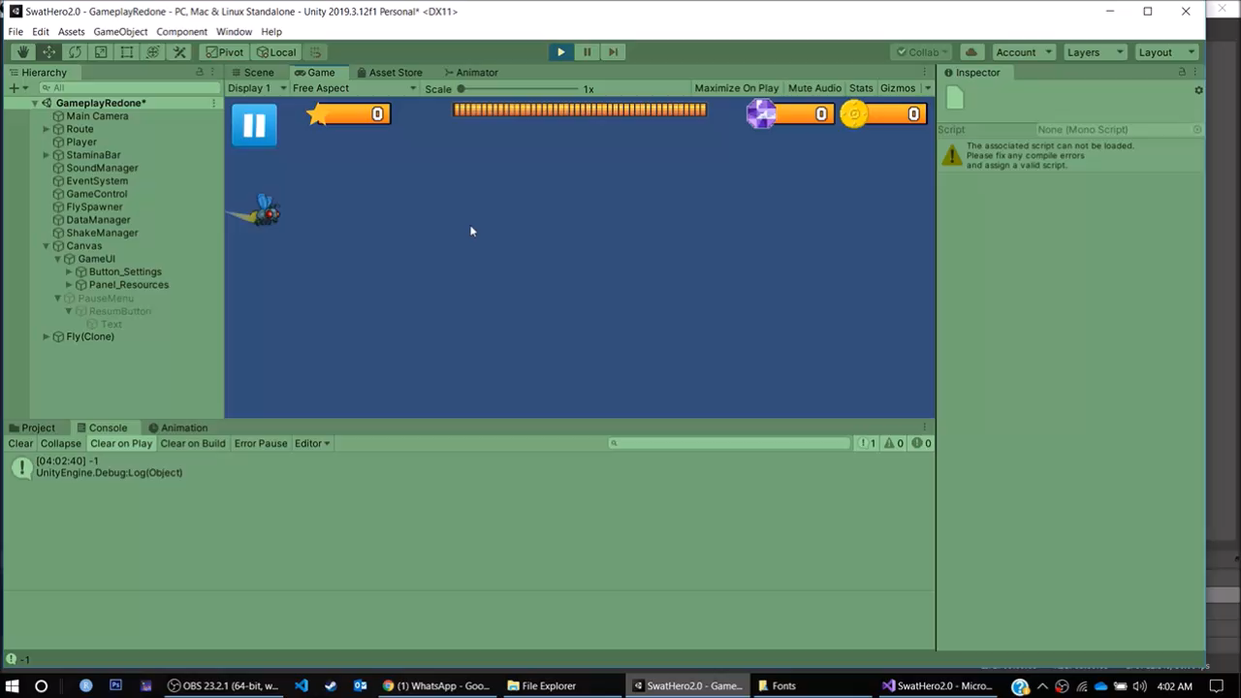
Swat hero

Slide 5
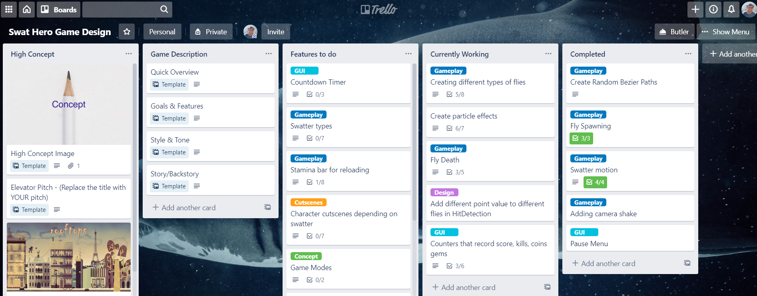
Features on Trello

Slide 6
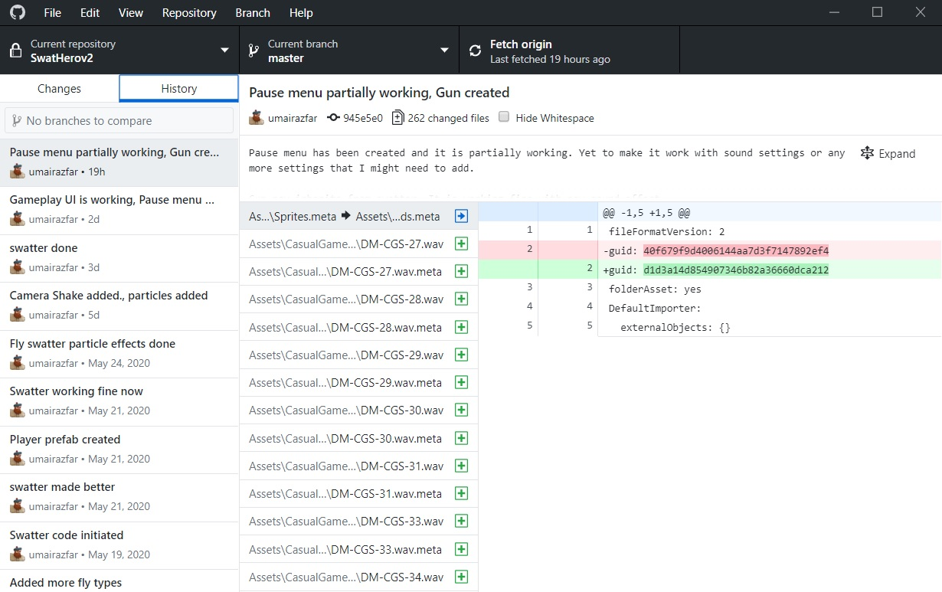
Git hub usage!
Ashamed of not using
Command line ☹
I have my reasons though!

Slide 7
What Iteration of Game?
Third iteration of the game
Reusing old code
Fixing design issues
Using proper OOP techniques
Simplifying the game mechanics
Got a few OFF THE SHELF components

Slide 8
Problems faced
Took some time to really understand how unity worked
Initial game concept was hard to code and was not fun enough
Got distracted and started working on a sub-project
Very limited time per day, 2-3 hours max (I take some time to get into my zone of coding)
Did not do a proper design (mainly because in Unity things are a bit different)

Slide 9
How can it be improved further?
Get the game skeleton up and running with all the major components in place
Use design patterns wherever possible. I am already using Factory, but can benefit from singleton
Stay focused. The only person keeping me on track is myself!

Slide 10
What are Design patterns?
Design patterns are generalized solutions to generalized problems that occur with some modicum of frequency when you're creating software using the object oriented programming paradigm. *reference: Design Patterns in Game Programming by Michael Haney (https://www.gamasutra.com/blogs/MichaelHaney/20110920/90250/Design_Patterns_in_Game_Programming.php)

Slide 11
Designing in OOP
Designing object-oriented software is hard,
and designing reusable object-oriented software is even harder.

Slide 12
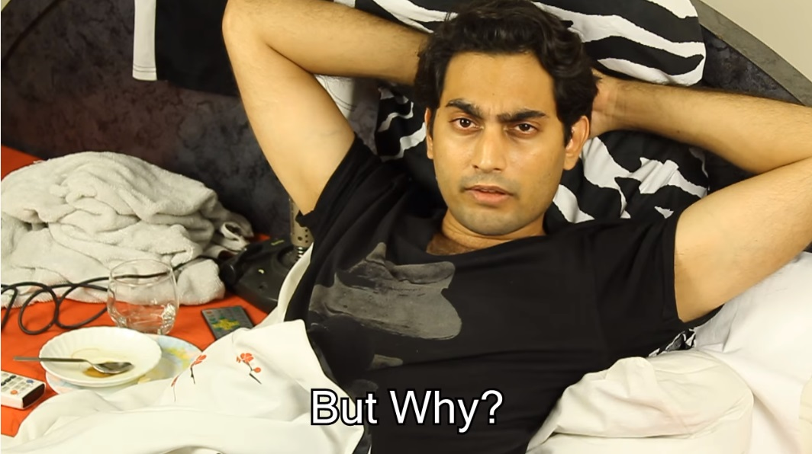
But Why?

Slide 13
But Why?
You must find pertinent objects,
factor them into classes at the right granularity,
define class interfaces and inheritance hierarchies,
and establish key relationships among them.

Slide 14
What a good design should be
Your design should be specific to the problem at hand but also general enough to address future problems and requirements.
You also want to avoid redesign, or at least minimize it.
Experienced object-oriented designers will tell you that a reusable and flexible design is difficult if not impossible to get "right" the first time.
Before a design is finished, they usually try to reuse it several times, modifying it each time.
It takes a long time for novices to learn what good object-oriented design is all about. As long as you keep trying, you will be OK!

Slide 15
Why use design patterns?
These solutions have existed for a relatively long time and many experts have used them.
They are likely better than any solution you could come up with on your own.
Knowledge of contextually pertinent design patterns helps you to make good architecture and design decisions.

Slide 16
A Design Pattern
In general, a pattern has four essential elements:
The pattern name is a handle we can use to describe a design problem, its solutions, and consequences in a word or two.
The problem describes when to apply the pattern. It explains the problem and its context.
The solution describes the elements that make up the design, their relationships, responsibilities, and collaborations. The solution doesn't describe a particular concrete design or implementation, because a pattern is like a template that can be applied in many different situations.
The consequences are the results and trade-offs of applying the pattern. They are critical for evaluating design alternatives and for understanding the costs and benefits of applying the pattern

Slide 17
A Design Pattern
A design pattern names, abstracts, and identifies the key aspects of a common design structure that make it useful for creating a reusable object-oriented design.
The design pattern identifies the participating classes and instances, their roles and collaborations, and the distribution of responsibilities

Slide 18
Types of Design Patterns
Creational
Structural
Behavioral

Slide 19
White-box reuse
Class inheritance lets you define the implementation of one class in terms of another's. Reuse by sub-classing is often referred to as white-box reuse.
The term “white-box” refers to visibility: With inheritance, the internals of parent classes are often visible to subclasses.

Slide 20
Black-box reuse
Object composition is an alternative to class inheritance. Here, new functionality is obtained by assembling or composing objects to get more complex functionality.
Object composition requires that the objects being composed have well-defined interfaces.
This style of reuse is called black-box reuse, because no internal details of objects are visible. Objects appear only as "black boxes."

Slide 21
Advantages of Inheritance
Class inheritance is defined statically at compile-time and is straightforward to use, since it's supported directly by the programming language.
Class inheritance also makes it easier to modify the implementation being reused.
When a subclass overrides some but not all operations, it can affect the operations it inherits as well, assuming they call the overridden operations.

Slide 22
Disadvantages of Inheritance
You can't change the implementations inherited from parent classes at run-time, because inheritance is defined at compile-time.
Parent classes often define at least part of their subclasses' physical representation. Because inheritance exposes a subclass to details of its parent's implementation, it's often said that “inheritance breaks encapsulation”.
The implementation of a subclass becomes so bound up with the implementation of its parent class that any change in the parent's implementation will force the subclass to change.

Slide 23
Advantages of Object Composition
Object composition is defined dynamically at run-time through objects acquiring references to other objects.
Because objects are accessed solely through their interfaces, we don't break encapsulation. Any object can be replaced at run-time by another as long as it has the same type.
Moreover, because an object's implementation will be written in terms of object interfaces, there are substantially fewer implementation dependencies.
Favoring object composition over class inheritance helps you keep each class encapsulated and focused on one task

Slide 24
Disadvantages of Object Composition
A design based on object composition will have more objects (if fewer classes)
The system's behavior will depend on their interrelationships instead of being defined in one class.

Slide 25
Two Principles of OOP Design
Program to an interface, not an implementation.
Favor object composition over class inheritance.

Slide 26
More in Next Lecture
To be continued…

